Slide 1
Enzyme and Growth Kinetics

Slide 5
Briggs-Haldane Approach
The quasi-steady-state assumption:
A system (batch reactor) is used in which the initial substrate concentration [S₀] greatly exceeds the initial enzyme concentration [E₀].
since [E₀] was small,
d[ES]/dt ≈ 0
- It is shown that in a closed system the quasi-steady-state hypothesis is valid after a brief transient if [S0]>> [E0].

Slide 6
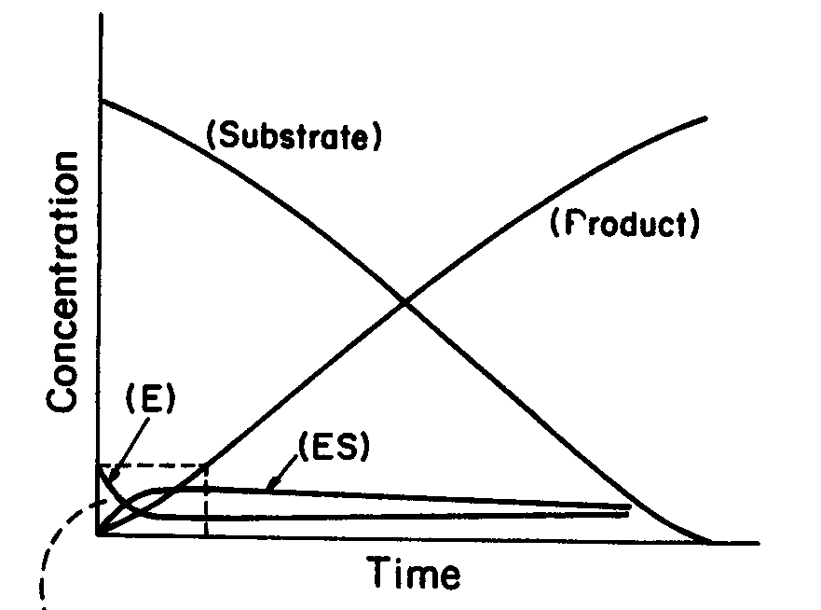
The quasi-steady-state hypothesis is valid after a
brief transient in a batch system if [S0]>> [E0].

Slide 7
Briggs-Haldane Approach
With such assumption, the equation representing the
accumulation of [ES] becomes
Solving this algebraic equation yields

Slide 8
Briggs-Haldane Approach
Then the product formation rate becomes
Then,
Where
same as that for rapid equilibrium assumption.
when K2 << k-1,

Slide 9
Briggs-Haldane Approach
Substituting the enzyme mass conservation equation
in the above equation yields
Using [S] to represent [ES] yields

Slide 10
Comparison of the Two Approaches
Michaelis-Menten
Briggs-Haldane
Assumption:
d[ES]/dt ≈ 0
Equation:
Maximum forward
reaction rate:
Constant:
when k2 << k-1,

Slide 11
Experimentally Determining Rate Parameters for Michaelis-Menten Type Kinetics.
To determine the rate parameters:
- Predict a specific enzyme catalysis system.
- Design bioreactor

Slide 12
The determination of Vm and Km are typically obtained from initial-rate experiments.
-A batch reactor is charged with known initial concentration of substrate [So] and enzyme [Eo] at specific conditions such as T, pH, and Ionic Strength.
The product or substrate concentration is plotted against time.
- The initial slope of this curve is estimated.
v=(d[P]/dt) , or = - (d[S]/dt) .
This value v depends on the values of [E0] and [S0].
- Many such experiments can be used to generate many pairs of V and [S] data, these data can be plotted as v-[S].

Slide 13
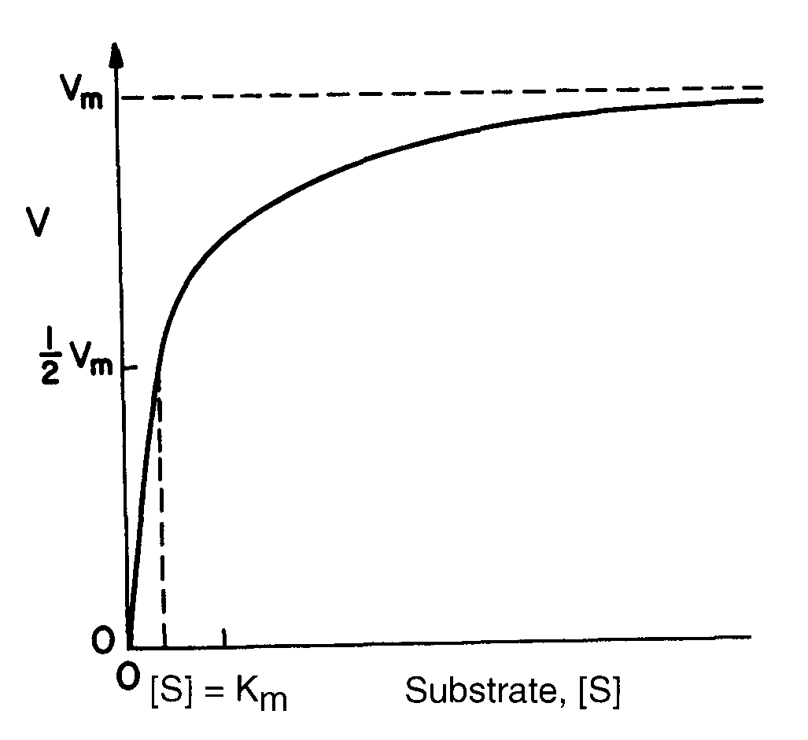

Slide 14
Lineweaver-Burk Plot (Double-Reciprocal Plot)
Linearizing it in double-reciprocal form:

Slide 15
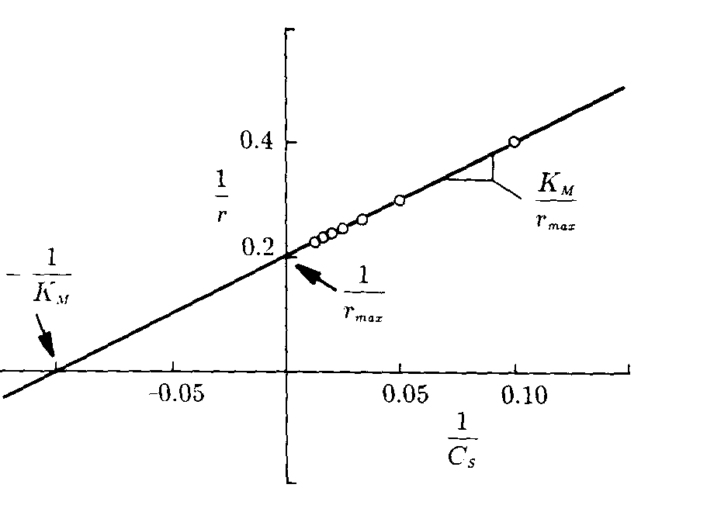
- Lineweaver-Burk plot (Double-reciprocal plot).
- a slope equals to Km/Vm
y-intercept is 1/Vm.
More often used as it shows the independent variable [S]
and dependent variable v.
-1/v approaches infinity as [S] decreases
- gives undue weight to inaccurate measurement
made at low concentration
- give insufficient weight to more accurate
measurements at high concentration.

Slide 16
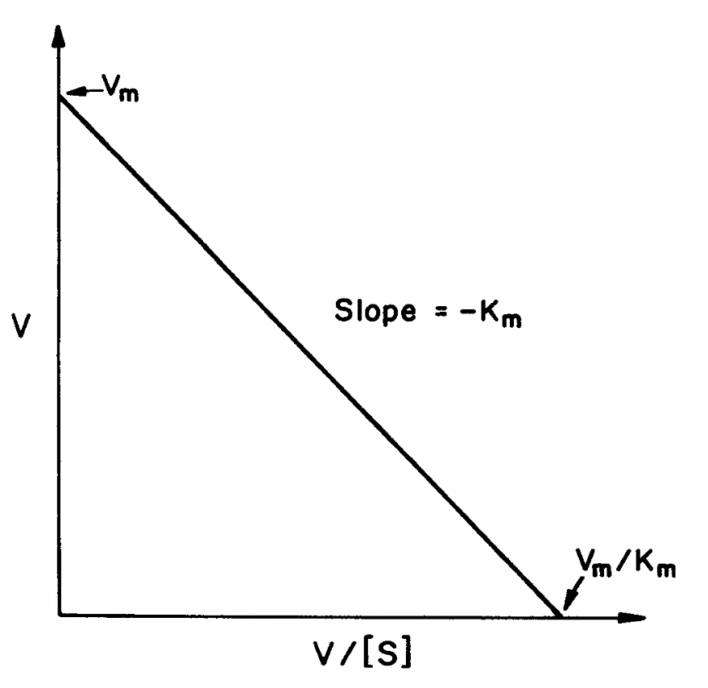
Eadie-Hofstee Plot
- the slope is –Km
- y-axis intercept is Vm.
Can be subject to large error since both coordinates contain
dependent variable v,
but there is less bias on points at low [s].

Slide 17
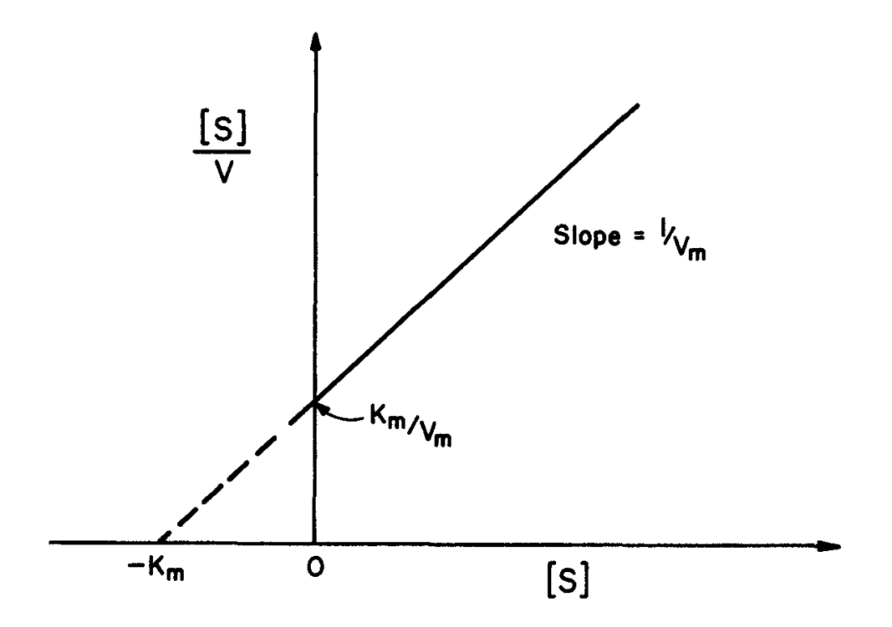
Hanes-Woolf (Langmuir) Plot
- the slope is –1/Vm
y-axis intercept is Km/Vm
better fit: even weighting of the data

